Slide 1

Phishing Attacks
What is Phishing?
Phishing is an attempt to steal sensitive information, such as usernames, passwords, credit card numbers, or bank account details, for personal gain or sale. Attackers masquerade as reputable sources, using enticing requests to lure victims into revealing this sensitive information, much like a fisherman uses bait to catch a fish.

Slide 2



How Phishing Works
The Three Stages of a Phishing Attack
Stage 1: Bait
Stage 2: Hook
Stage 3: Catch
Attacker prepares: - Fake websites/emails - Convincing content - Urgency triggers - Social engineering tactics
In many scams the hook involves making the target believe that one of their accounts have been compromised, creating a sense of urgency and making the target act quickly - perhaps without thinking. The attacker can then redirect the target to follow a link to a page where they can harvest the victim's details[8].
- Credentials captured - Data stolen - Malware installed - Financial fraud executed

Slide 3
Techniques Used by Attackers
Attackers use several tactics to make phishing attempts more effective[1]:
Finding, purchasing, or scraping
Setting up fake websites and apps
DNS fast fluxing
Domain spoofing and email spoofing
to disguise hosting servers
known contact information
that imitate real ones
to make messages appear legitimate
Manipulating links
Sending emails from trusted infrastructure
Using generative AI
so URLs in phishing messages look correct
to quickly create realistic, error-free messages
that can pass spam filters

Slide 4




Types of Phishing Attack
Email Phishing
Spear Phishing
Whaling
Most common form: - Fake sender address - Malicious links - Infected attachments - Urgency tactics Example: "Your account will be suspended in 24 hours. Click here to verify your information immediately."
Spear phishing is directed at specific individuals or companies. By gathering details or buying information about a particular target, an attacker is able to mount a personalized scam. This is currently the most effective type of phishing.
A whaling attack is a phishing attack that targets a senior executive. These individuals often have deep access to sensitive areas of the network, so a successful attack can result in access to valuable info.
An email from a seemingly legitimate sender tries to trick the recipient into following a malicious link and/or downloading an infected file.
The attacker typically already has some or all of the following information about the victim:
Real-world example: A founder of Levitas, an Australian hedge fund, was the target of a whaling attack that led the individual to a fake connection using a fraudulent Zoom link. After following the link, they had malware installed on their system, and the company lost $800,000[3].
- Full name - Job title - Email address - Company name - Colleagues' names - Recent activities - Personal interests

Slide 5

Website Forgery
Business Email Compromise (BEC)
Process:
According to the Anti-Phishing Working Group (APWG), BEC attacks grew more frequent in 2023, but scammers asked for less money on average with each attack.
Create identical copy of legitimate website
Register similar domain name
Lure victims via email/search
Capture entered credentials
Redirect to real site to avoid suspicion
Common BEC scenarios:
CEO fraud (impersonating executives)
Invoice fraud
Attorney impersonation
Data theft
W-2 phishing

Slide 6



Phishing as a Service (PhaaS)
QR Code Phishing (Quishing)
Advanced-Fee Scam
In the 2020s, PhaaS platforms like Darcula allow attackers to easily fake trusted websites. Evilginx, originally created as an open-source tool for penetration testing, has been repurposed by cybercriminals for MitM attacks. Evilginx works like a middleman, passing information between the victim and the real website without saving passwords or login codes, making it harder for security systems to detect.
Method:
This common email phishing attack was popularized by the "Nigerian prince" email, where an alleged Nigerian prince offers to give the victim a large sum of money for a small fee upfront. This type of scam has been occurring for over a hundred years in different forms; it was originally known in the late 1800s as the Spanish Prisoner scam.
Embed malicious URL in QR code
Place in emails, posters, flyers
Bypass email security filters
Redirect to phishing site
Why effective:
Hard to inspect QR code destination
Mobile devices less protected
Growing QR code trust

Slide 7




Smishing (SMS Phishing)
Vishing (Voice Phishing)
SMS phishing uses fake text messages to trick targets. Scammers commonly pose as the victim's wireless provider, sending a text that offers a "free gift" or asks the user to update their credit card information. Some smishers pose as the US Postal Service or another shipping company, sending texts that tell victims they must pay a fee to receive a package.
Method:
Phone calls impersonating legitimate organizations
IRS/tax authority scams
Bank fraud alerts
Tech support scams
Social Security scams
Tactics:
Caller ID spoofing
Urgent language
Threatening consequences
Requesting immediate action
Clone Phishing
HTTPS Phishing
Clone phishing involves mimicking a previously delivered legitimate email and modifying its links or attached files in order to trick the victim into opening a malicious website or file. By taking an email and attaching a malicious file with the same filename as the original, and then resending it with a spoofed email address that appears to come from the original sender, attackers exploit the trust of the initial communication.
An HTTPS phishing attack is carried out by sending the victim an email with a link to a fake website. The site may then be used to fool the victim into entering their private information. Hacker group Scarlet Widow searches for employee emails of companies and then targets them with HTTPS phishing.

Slide 8
Phase 1: Reconnaissance
Information gathering:
1. OSINT (Open Source Intelligence)
3. Target profiling
LinkedIn profiles
Company websites
Social media
Public records
Identify key personnel
Map organizational structure
Find relationships
Identify vendors/partners
2. Email harvesting
theHarvester tool
Hunter.io
LinkedIn scraping

Slide 9
Phase 2: Infrastructure Setup
Setting up robust defenses involves actively monitoring for potential phishing domains that mimic legitimate ones. This proactive approach uses domain similarity analysis to identify typosquatting and other deceptive variations for defensive monitoring.
Proactive Domain Monitoring
Typosquatting Analysis
Homoglyph & Deceptive Variations
Continuously scan for look-alike domains that attempt to mimic legitimate brand names. Early detection enables swift action against potential threats.
Identify domains created by making minor typographical errors, such as character omissions, duplications, or adjacent swaps, designed to trick unsuspecting users.
Uncover domains utilizing visually similar characters (homoglyphs like 'o' for '0') or employing common Top-Level Domain (TLD) changes (e.g., .com to .co) to appear legitimate.
Example: examplebank.com vs examp1ebank.com
Example: example.com vs exarnple.com

Slide 10
Phase 3: Content Creation
Email crafting elements:
01
02
Subject line (urgency/curiosity)
Sender spoofing
"URGENT: Account suspended"
"Security alert: Unusual activity"
"Your payment failed"
"Important document shared with you"
Display name manipulation
Domain lookalikes
Subdomain tricks
Unicode character substitution
03
04
Email body
Malicious payload
Official branding/logos
Professional language
Urgency creation
Clear call to action
Phishing links
Malicious attachments
Embedded macros
Drive-by download links

Slide 11
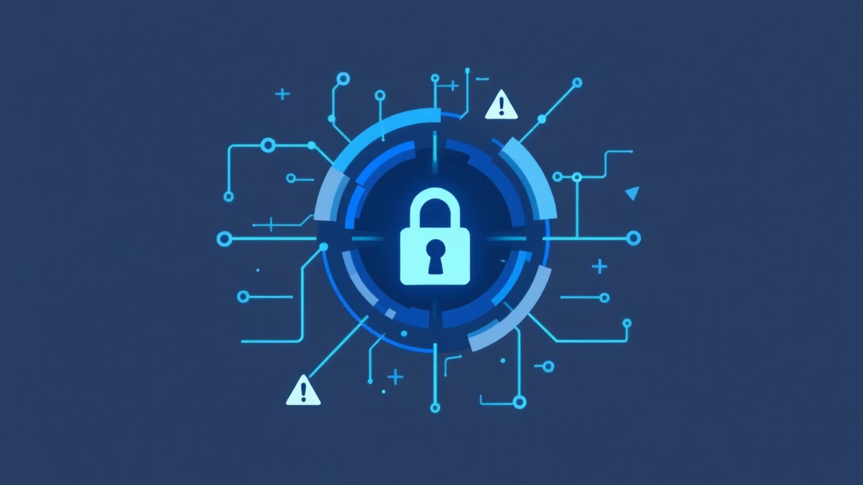




Phase 4: Delivery
Delivery methods for phishing attacks:
Mass email campaigns
Targeted spear phishing
SMS messages
Social media messages
Phone calls
Physical media (USB drops)
Search engine poisoning
Malvertising

Slide 12
Phase 5: Exploitation
Key Exploitation Techniques
Fake Login Forms
Malicious File Downloads
Credential Harvesting via Social Engineering
Malware Injection & Drive-by Downloads
Attackers replicate legitimate login pages to capture usernames and passwords as victims attempt to log in, often redirecting them to the real site afterward to avoid suspicion.
Victims are tricked into downloading files (e.g., invoices, reports, software updates) that are actually malware, ransomware, or spyware, often disguised as legitimate documents.
Exploiting vulnerabilities in browsers or software, attackers can force malware onto a victim's device without their explicit interaction (drive-by download) or through malicious code injected into compromised websites.
Leveraging urgency, fear, or curiosity, attackers coax victims into voluntarily entering credentials into fraudulent forms or websites.

Slide 13
Scrutinize Login Forms
SSL Certificate Verification
Identify Brand Impersonation
Observe Unusual Form Behaviors
Always verify the URL in the address bar. Be wary of login forms that appear in an email or pop-up and submit data to unfamiliar or external domains.
Check for a valid SSL certificate (HTTPS and padlock icon) in the browser. While not foolproof, missing or invalid certificates are a strong indicator of a fraudulent site.
Look for subtle inconsistencies in branding, grammar, spelling, and tone that differ from legitimate communications from the purported sender.
Legitimate forms usually perform client-side validation or provide clear error messages. Suspicious forms might accept any input, behave unexpectedly, or immediately redirect without clear confirmation.

Slide 14
Phase 6: Credential Harvesting
Data collected by attackers:
Usernames/passwords
Credit card numbers
Social security numbers
Bank account details
Personal information
Session cookies
MFA codes (real-time phishing)
Phase 7: Post-Exploitation
What attackers do with stolen data:
Account takeover
Financial fraud
Identity theft
Sell on dark web
Lateral movement in corporate networks
Ransomware deployment
Business email compromise
Extortion

Slide 15

Real-World Attacks
Twitter Bitcoin Scam (2020)
Using details supplied by unsuspecting employees, hackers were able to seize control of several high-profile user accounts, including those of Barack Obama, Elon Musk, Joe Biden, and Apple Inc.'s company account. The hackers then sent messages to Twitter followers soliciting Bitcoin, promising to double the transaction value in return. The hackers collected 12.86 BTC (about $117,000 at the time).
Account Deactivation Scam
1
2
Email claiming account will be deactivated
Creates urgency (24-48 hour deadline)
3
4
Link to fake login page
Credentials captured
5
6
Victim redirected to real site
Victim unaware of compromise

Slide 16





Phishing Detection Techniques
Effective identification of phishing attempts relies on analyzing multiple email and URL characteristics. By scrutinizing these key indicators, organizations can significantly enhance their defenses against malicious campaigns.
Reply-To vs. From Mismatch
SPF/DKIM/DMARC Checks
Suspicious URL Detection
Detect discrepancies where the 'Reply-To' address differs from the 'From' address, a common tactic used by phishers to redirect responses.
Verify email authentication protocols. Failure in SPF (Sender Policy Framework), DKIM (DomainKeys Identified Mail), or DMARC (Domain-based Message Authentication, Reporting & Conformance) indicates potential spoofing.
Scan for unusual URL structures, including the use of IP addresses instead of domain names, excessive subdomains, or the presence of suspicious Top-Level Domains (TLDs) like .xyz or .top.
Urgency Keywords
URL Length Analysis
Identify phrases in subject lines or body text that create a false sense of urgency or threat, such as "URGENT," "IMMEDIATE ACTION REQUIRED," or "ACCOUNT SUSPENDED," to pressure recipients into hasty decisions.
Flag unusually long URLs, which can be an indicator of obfuscation used by attackers to hide malicious destinations or embedded credentials.

Slide 17
Defense Against Phishing
Technical Controls
Email Security:
Network Security:
✓ SPF (Sender Policy Framework)
✓ DKIM (DomainKeys Identified Mail)
✓ DMARC (Domain-based Message Authentication)
✓ Email filtering/sandboxing
✓ Anti-phishing gateways
✓ URL scanning and rewriting
✓ Attachment sandboxing
✓ Web filtering/proxy
✓ DNS filtering
✓ SSL inspection
✓ Intrusion detection systems
✓ Zero Trust architecture
Two-Factor Authentication (2FA)
Two-factor authentication is the most effective method for countering phishing attacks, as it adds an extra verification layer when logging in to sensitive applications. 2FA relies on users having two things: something they know, such as a password and username, and something they have, such as their smartphones.

Slide 18






Awareness
Recognizing phishing emails
Verifying sender identity
Checking URLs before clicking
Reporting suspicious emails
Safe browsing practices
Social engineering awareness
Simulated phishing exercises

Slide 19




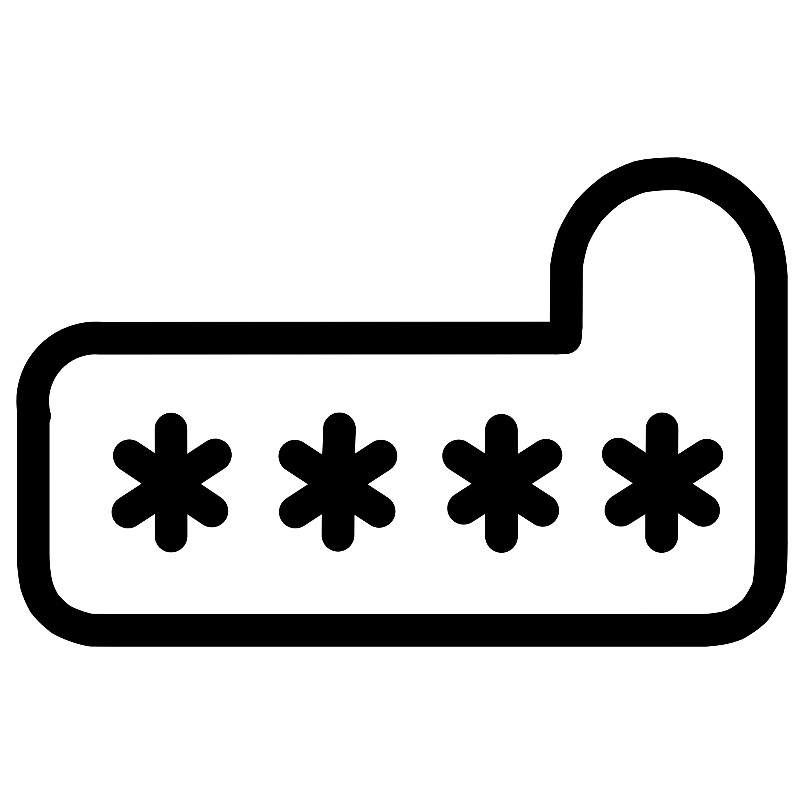

Incident Response for Phishing
When phishing detected:
Don't click any links
Report to IT/security team
Preserve email headers
Block sender domain
Scan affected systems
Reset compromised credentials
Notify affected users
Document incident
Update security controls

Slide 20

Advanced Phishing Techniques

Slide 21
Real-Time Phishing (Adversary-in-the-Middle)
How AiTM Phishing Works
Traditional phishing: Victim → Fake Site → Stolen credentials
AiTM Attack Flow
AiTM Phishing: Victim → Proxy (Attacker) → Real Site ↓ Captures session cookies Bypasses MFA completely
Step 1: Setup reverse proxy
Step 2: Send phishing email with proxy URL
Step 3: Victim visits proxy URL
Step 4: Proxy forwards to real website
Step 5: Victim enters credentials
Step 6: Proxy captures credentials AND session cookies
Step 7: Attacker uses session cookie (bypasses MFA)
Step 8: Full account access achieved
Tools Used
Evilginx2
Modlishka
Muraena
Canarytokens
Reverse proxy framework
Reverse proxy tool
Phishing proxy
Detection tool
Defense:
FIDO2/WebAuthn hardware keys
Conditional access policies
Device compliance checks
Anomaly detection

Slide 22
Browser-in-the-Browser (BitB) Attack
How BitB Works
Concept:
Simulate browser popup window using HTML/CSS
Fake "Sign in with Google/Microsoft" popup
Appears completely legitimate
Captures credentials silently
Example HTML structure:
<!-- Fake browser window simulation -->
<div class="window-container">
<!-- Fake browser chrome -->
<div class="browser-toolbar">
<div class="browser-buttons">
<span class="btn-close"></span>
<span class="btn-minimize"></span>
<span class="btn-maximize"></span>
</div>
<!-- Fake URL bar showing legitimate domain -->
<div class="url-bar">
<span class="lock-icon">

Slide 23


Deepfake Phishing
AI-Powered Attacks
Voice Cloning:
Video Deepfakes:
Clone executive voice using AI
Call employees requesting urgent action
Wire transfers, credential sharing
Bypass voice verification systems
Fake video calls impersonating executives
Used in BEC attacks
Increasingly convincing
Difficult to detect in real-time
Real case: A UK energy company CEO was tricked into transferring €220,000 after receiving a call from what sounded exactly like his parent company's CEO - actually an AI-generated voice clone.

Slide 24
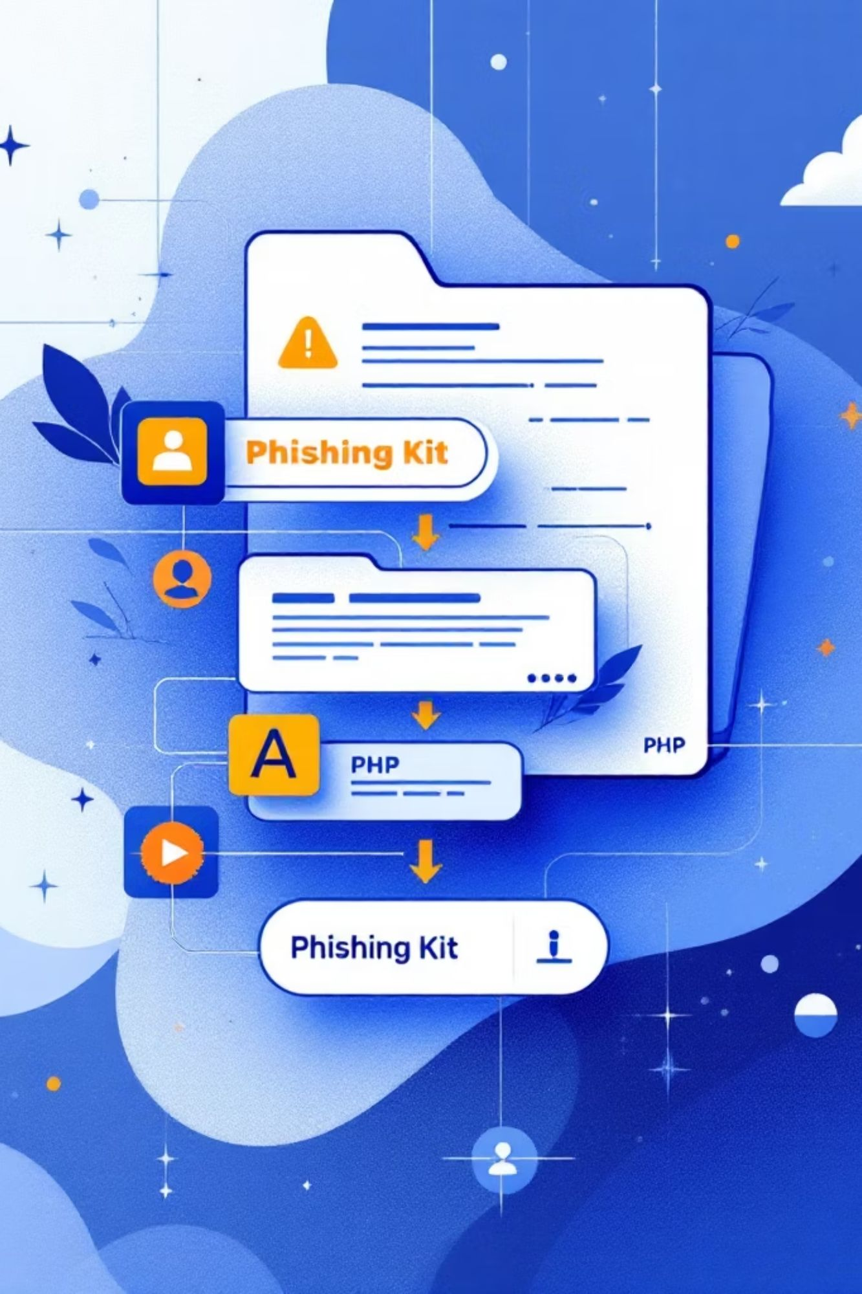
Phishing Kit Analysis
Common Phishing Kit Components
Typical kit structure:
phishing_kit/
├── index.php # Main phishing page
├── login.php # Credential capture
├── redirect.php # Redirect to real site
├── assets/
│ ├── css/ # Copied from real site
│ ├── js/ # Copied from real site
│ └── images/ # Copied logos/images
├── logs/
│ └── credentials.txt # Stolen data storage
└── config.php # Attacker email/settings

Slide 25

Social Engineering Tactics
Psychological Manipulation Techniques

Slide 26
1. Authority
Technique:
Example:
Impersonate authority figures
CEO, IT department, government agencies
Law enforcement, banks, tax authorities
"This is the IT department. We detected unauthorized access to your account. You must verify your credentials immediately to prevent account lockout."
Defense:
Verify identity through official channels
Call back using known numbers
Follow verification procedures

Slide 27
2. Urgency & Fear
Technique:
Example:
Defense:
Create time pressure
Threaten negative consequences
Exploit fear of loss
"Your account will be permanently deleted in 2 hours unless you verify your identity. Click here NOW to prevent this."
Take time to verify
Legitimate organizations don't rush
Contact company directly

Slide 28
3. Social Proof
Technique:
4. Reciprocity
5. Scarcity
Reference colleagues or trusted contacts
"Your colleague John already updated his info"
Fake testimonials and reviews
Offer something valuable first
Free gift, prize, reward
Creates sense of obligation
Limited time offers
"Only 3 spots remaining"
Creates FOMO (Fear of Missing Out)
Example: "You've been selected for a free iPhone! Just verify your shipping details."
Defense:
Don't make rushed decisions
Research before acting
Example: Your colleague John already updated his info — you should too, or you'll miss the deadline!
Defense:
Be skeptical of unexpected rewards
Research offers independently
Defense:
Verify with colleagues directly
Don't trust unverifiable claims

